Slide 1



Investing in Senior Living Development
Investment, Development, and Operating Models.
Prof Kola Akinsomi. Ph.D., MRICS.
President, African Real Estate Society.
Associate Professor, Wits University.
Chief Economist, RealQuant Analytics.

Slide 2
Senior Living in South Africa
Senior Living in South Africa could be an attractive real estate sector for investors due to the number of people who might soon need it.
In 2022, the estimated population of South Africa included more than 5.6 million people aged 60 or older. This represents a 9.2% share of the overall South African population
South Africans are living longer and the over-60s are a growing market, Its over-60 population is expected to double by 2050 and comprise 15.4% of the total population, according to the World Health Organization.
This makes retirement development a “worthwhile long-term investment”

Slide 3
Percentage of Elderly Aged- 60+

Slide 4
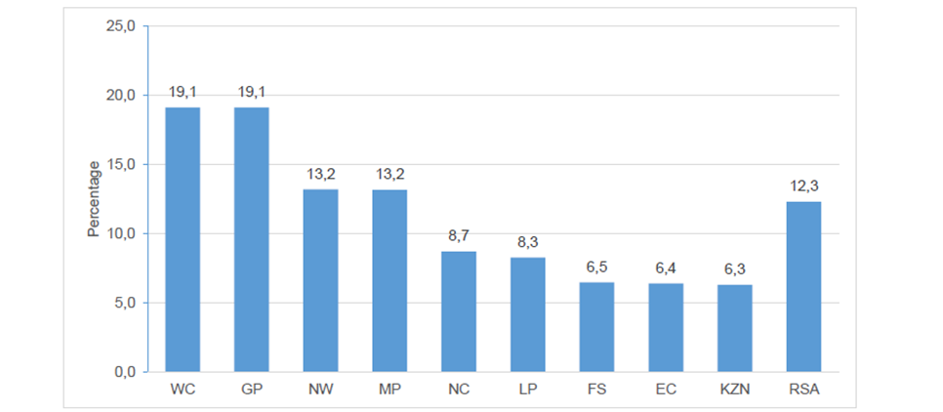
Percentage Growth of older persons 2017 and 2022

Slide 5
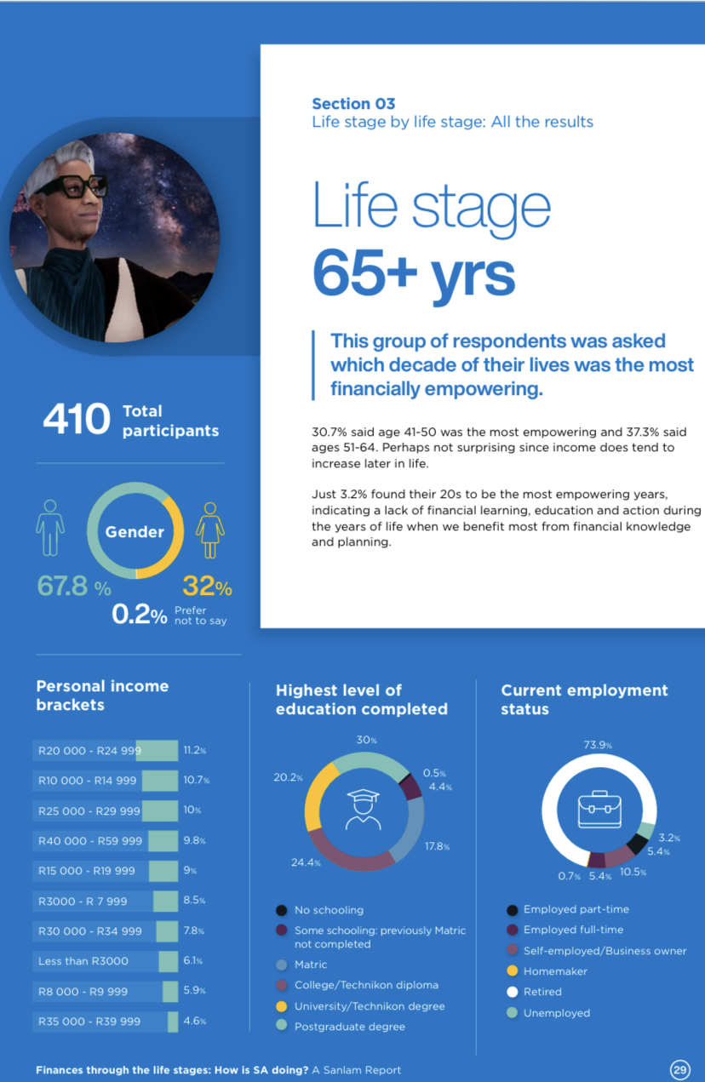
65+ Affordability Issues in Retirement Living
Source: Sanlam

Slide 6
Senior Living: Why Invest?
During the great recession in the U.S (2007 to 2009), Senior housing and care was the only commercial real estate asset class to experience “positive rent growth”. Recession resistant?
Number of Seniors are rising- expected to double by 2050 and comprise 15.4% of the total population
Offers exposure to an alternative/niche investment asset class- diversification from traditional residential investments

Slide 7
Senior Living: Investment Opportunities
Senior Living Fund: Auria Senior Living (Majority shareholder- Mary Oppenheimer family interests)
Senior Living REITs: that own and operate senior living facilities—are generally a part of the healthcare REIT sector (Growthpoint Healthcare Property Holdings (GHPH)
Convert an existing property into a senior living facility: Re-purposing or Adaptive Re-use
Consider local demand and access
Zoning Regulations

Slide 8
Senior Living: Investment Opportunities
Buy commercial property, pass off operations to a third party
Earn passive profits with less risk and liability.
A management company (a senior living operator) will handle any day-to-day issues
Buy and operate a senior living facility
Buying an existing senior living community is the most direct way to invest in senior housing

Slide 9
Senior Living: Operating Models
The South African model is largely a “private pay model”: Senior living is seldom funded by government or health insurers, hence residents fund their living and care costs individually
Life Occupancy Right: Life rights ownership entails purchasing the right to use the property for the remainder of your life, with the security of tenure forming the foundation of this type of contract
A life rights scheme is a purchase agreement between the developer and the unit holder which guarantees the right to use the property or unit for the rest of the purchaser’s life – or, in the case of couples, on the death of the second-dying spouse

Slide 10
Senior Living: Operating Models
Life Rights System: This means that a resident buys the rights to occupy a certain unit. In addition to the cost of the unit the resident will also need to pay a monthly levy, which covers rates, electricity and water. The levy cost is based on the square meterage of the unit.
Upon termination of the agreement the purchaser or the purchasers estate shall be entitled to receive a portion of the resale price of the life right.
Full Ownership of own unit in a sectional title complex- Own unit as investment.

Slide 11
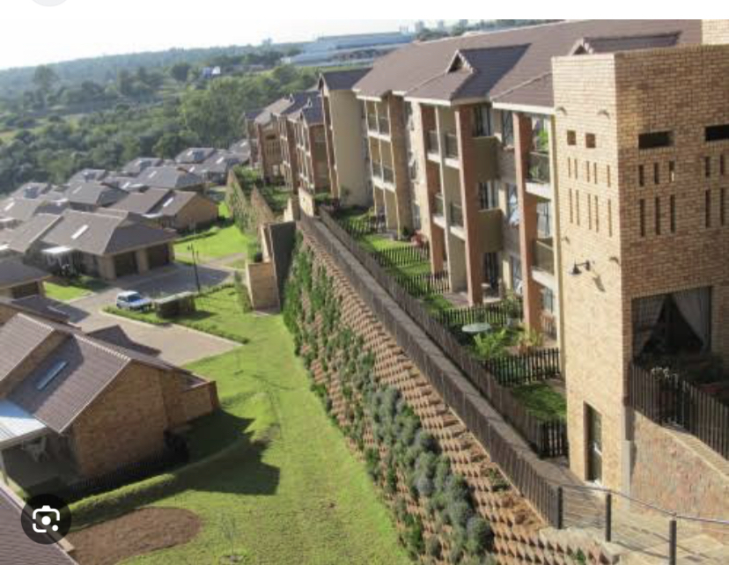
Senior Living Developments: A variability in choice
City Living: Developer- Central Developments Property Group Olivedale Retirement Village (Affordable?)
R580,000 to R3m: Location: Randburg

Slide 12
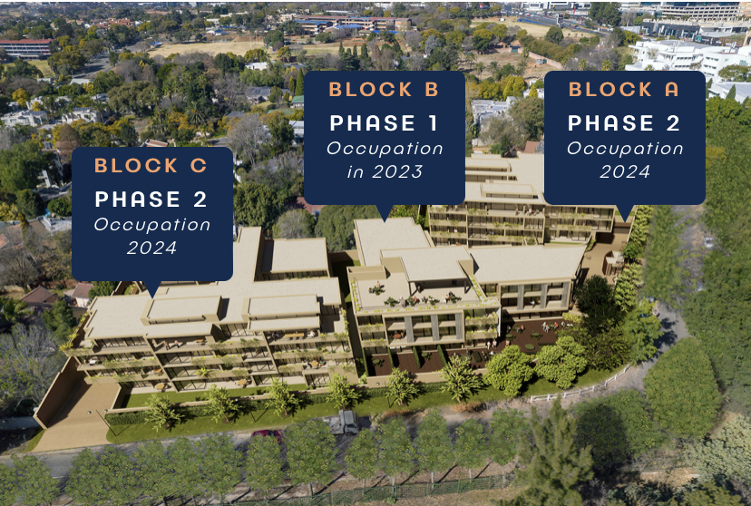
Senior Living Developments: A variability in choice
City Living: Developer- Circle Senior Living (Premium?)
R2.5m to R8m: Location: Sandown

Slide 13
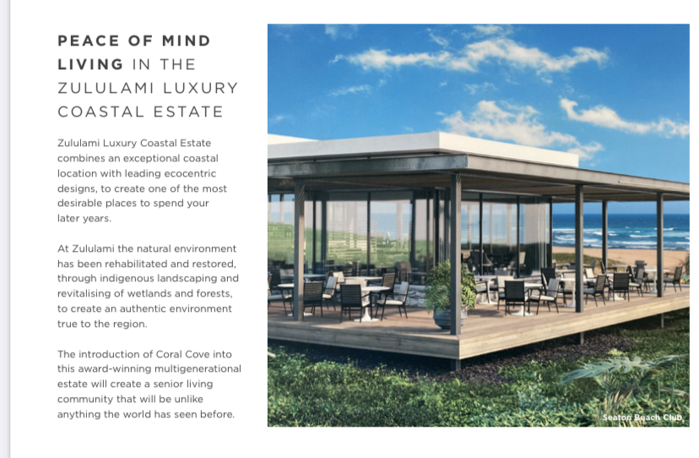
Senior Living Developments: A variability in choice
Coastal Living: Developer- Auria Senior Living (Premium)
ZARN/A: Location: KZN North Coast

Slide 14
What makes Senior Living Development a Success?
Location: of importance in senior living development
Amenities: Coffee Shops/Cinemas/Dining options/recreation
Assisted Care: Assisted Living Facilities or Care at home (Dementia Care), Frail Care
Thriving communities: with a focus on quality of life
Affordability: Targeting right demographics

Slide 15
Senior Living as a Product: Trends
Current Challenges: Economic Turmoil and Uncertainty, Rising interest rates, high inflation rates.
Players in Senior Living would need to differentiate themselves from competitors.
Think through different operational models to accommodate the rise in rental active adult communities (opportunity for the middle market senior housing).
Amenity-rich housing with health care services
Rise in integrated care models: onsite care assistance (JV with health care providers)
Increase in consumer penetration: more on onboarding
ESG as a part of business strategy
Could we have a Senior Living REIT?

Slide 16
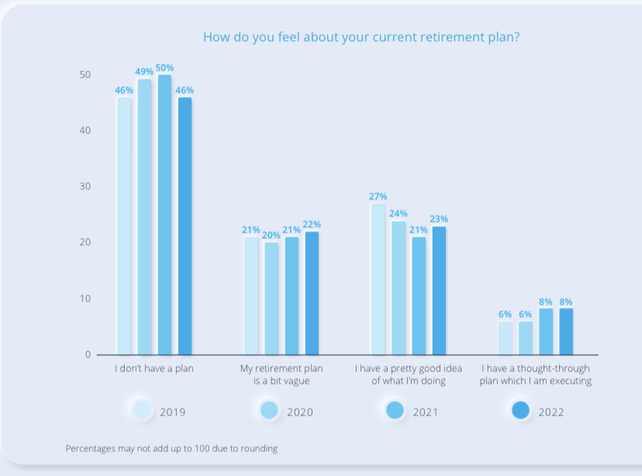
Why Retirement living will continue to remain “Exclusive”
Source: 10x

Slide 17

Prof Kola Akinsomi (Ph.D, MRICS)
Associate Professor, The University of the Witwatersrand, South-Africa Chief-Economist, RealQuant Analytics
BSc, Oxford Brookes University, England
MSc and PhD, National University of Singapore
President (African Real Estate Society)
President-Elect- 2025 (International Real Estate Society)
Research Committee Member (SA REITs Association)
Advisory Member, South African Council for Property Valuers Profession (SACPVP)
NRF (C-2) Rated Researcher (South Africa)
Editorial Board Member (JPIF, JREMV, JOSRE)
E-mail: kola.Akinsomi@wits.ac.za

Slide 18



